Slide 1
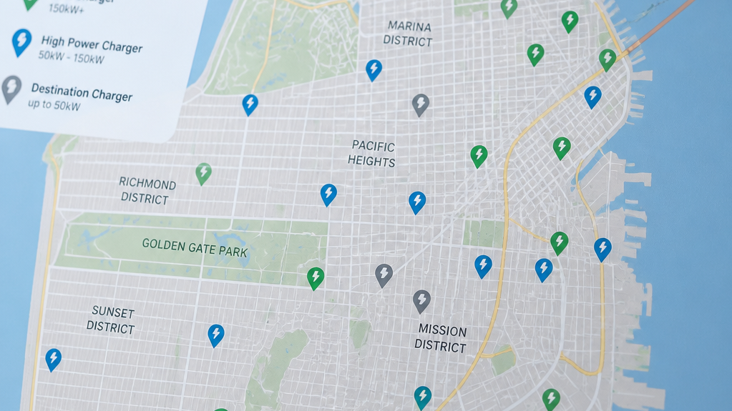
Strategic Optimization of Electric Vehicle Charging Infrastructure in Niagara Falls, Ontario
A Mixed-Integer Linear Programming Approach with Renewable Sourcing, Temporal Demands, and Priority Weighting
Final Group Project
Oscar Lopez Ochoa
Course: DAM0610 Operations Analytics
Cindy Paredes
German Meins

Slide 2
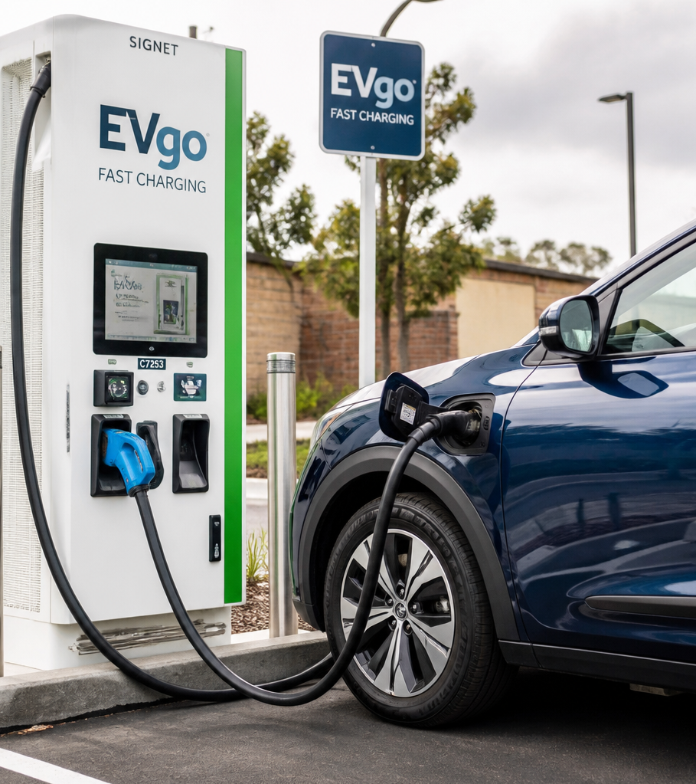
Key Challenges
Unregulated EV Infrastructure Growth
Commercial Motivation: Operators prioritize high- density locations to maximize charger utilization and profitability.
Grid Constraints: Unregulated clustering of high- power DC fast chargers risks overloading localized municipal power grids.
The Infrastructure Gap: Rapid adoption rates often outpace utility-side capacity planning and distribution upgrades.
Operational Risk: Potential for localized grid instability, increased demand charges, and service bottlenecks in high-demand areas.

Slide 3



Strategic Milestones
Operational Optimization Framework
Our three-pillar approach for operational optimization
Spatial Modeling
MILP Optimization
Grid Capacity Integration
Developing comprehensive spatial models of urban vehicle traffic to identify efficiency gaps.
Minimize total infrastructure and operational costs across a $350,000 capital budget.
Extending the core model to A time-of-use grid capacity thresholds for sustainable planning.

Slide 4
Building on Bian et al. (2021)
The primary reference is derived from the work of Bian, Liu, and Wang (2021)
Theoretical Foundations
Addressing the Infinite Grid Assumption
Practical Implementation
Grounding current research in the methodologies established by Bian and Li.
Integrating real-world constraints including transmission limits, congestion, and localized bottlenecks.
Moving beyond the original 2019 study's model of infinite power capacity.

Slide 5
Modeling Environment Dimensions
Spatial Parameters and Infrastructure Specifications
Demand Nodes
28
Fast Chargers: 50 kW output; 30-minute optimal duration.
discrete locations
Candidate Sites
12
Slow Chargers: 7 kW output; 240-minute optimal duration.
potential lots

Slide 6


Geographic Connectivity Constraints
Binary Spatial Coverage Matrix (A_ij)
Park A
Park B
Park C
Park D
Node 1
1
0
Node 2
0
1
Node 3
1
Node 4
1
Ensures all assigned traffic nodes remain within the designated service perimeter, guaranteeing accessibility and compliance.

Slide 7


The Optimization Architecture
Key components of our revenue and operational model
Decision Variables
Objective Function
Includes binary variables for station status, integer variables for charger counts, and demand capture estimates based on traffic and location.
Designed to minimize total system cost: capital expenditure, operational energy costs, and weighted unmet demand penalties.

Slide 8

Hard Boundary Limits
Operational constraints and capacity constraints for infrastructure
Demand Cap
Throughput Bound
Logical Coupling
Satisfied volume cannot exceed the total traffic experienced by the node.
Station-level volume is restricted to the specific charger hardware operating limits.
Chargers can only be deployed if the parent station is confirmed as operational and open.

Slide 9
Strategic Framework
Global Expansion Limits
Primary Constraint: The Extended Model optimally selects 6 stations (IDs: 1, 3, 5, 7, 8, 10) within the $350,000 budget. The Baseline Model builds 3 stations (IDs: 5, 8, 10) at a cost of $131,175..
Strategic Objective: Transition from broad network coverage to targeted high-value investment.
Decision Framework:
Prioritization: Selection process focuses on nodes with the highest projected ROI.
Asset Allocation: Capital is concentrated on assets that deliver maximum municipal impact within the defined budget envelope.
Solver Logic: Optimization algorithms must account for policy-driven boundaries while identifying critical service gaps.

Slide 10
Integrating Power Grid Thresholds
Constraint 5: Custom Extension
Electrical Threshold Definition
Each candidate lot is assigned a specific electrical capacity limit.
Peak Power Monitoring
Real-time tracking of demand against defined operational thresholds.
Penalty Mechanism
Calculates kilowatt overload when thresholds are exceeded.
Economic Impact
Overload penalties are integrated into the objective function to influence operational profit.
Overload penalties are integrated directly into the objective function, reducing overall operational profits.

Slide 11




Python Backend & Google OR-Tools
Technical Implementation Overview
Data Generation
Matrix Mapping
Constraint Definition
Solver Execution
Automated ingestion and preprocessing of raw operational requirements.
Precise translation of business logic into mathematical coefficient matrices.
Comprehensive implementation of linear, logical, and boundary constraints.
Efficient solving of Mixed Integer Programming (MIP) models with error handling and validation.
Modular design ensures reliability and scalability across the entire optimization lifecycle using the SCIP solver back-end.

Slide 12
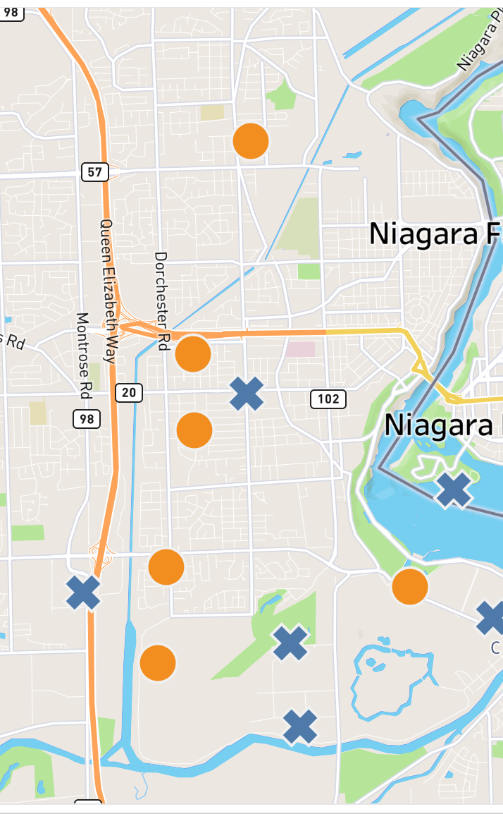
Strategy Comparison
Policy Cap Trade-offs
Model Results: Baseline vs. Extended
Baseline Model (3 stations built — IDs: 5, 8, 10)
CAPEX: $131,175 | Unmet demand: 0 cars
Simple cost minimization, no renewable sourcing, no equity weights
Extended Model (6 stations built — IDs: 1, 3, 5, 7, 8, 10)
CAPEX: $280,724 | Total cost: $284,596.48 | Unmet demand: 0 cars
Multi-source energy, peak/off-peak tariffs, priority weighting

Slide 13

Sensitivity Analysis: What-If Scenarios
Impact of Sensitivity on Grid Fee Structuring
Scenario A — Budget Tightening
Scenario B — Penalty Rate Sweep
At $200K budget: 4 stations built, 161 cars unserved. At $100K: only 2 stations, 465 unserved.
Tipping point at $1,000/car: full coverage triggered. Below $500/car the solver skips stations and pays penalties instead.

Slide 14



Workload Distribution & AI Integration
Optimizing team collaboration and development velocity
Strategic Framework for Modern Development
Collaborative Data & Metrics
AI-Powered Acceleration
Operational Efficiency
Fostering cross-functional teamwork via standardized, consistent data pipeline interpretation and shared responsibility.
Automating syntax validation, rapid debugging, and complex matrix troubleshooting to ensure production- ready code.
Reducing time-to-market by delegating repetitive verification tasks to intelligent agents, allowing focus on high-impact development.
UNIFIED WORKFLOWS DRIVING TECHNICAL EXCELLENCE AND DELIVERY SPEED.

Slide 15
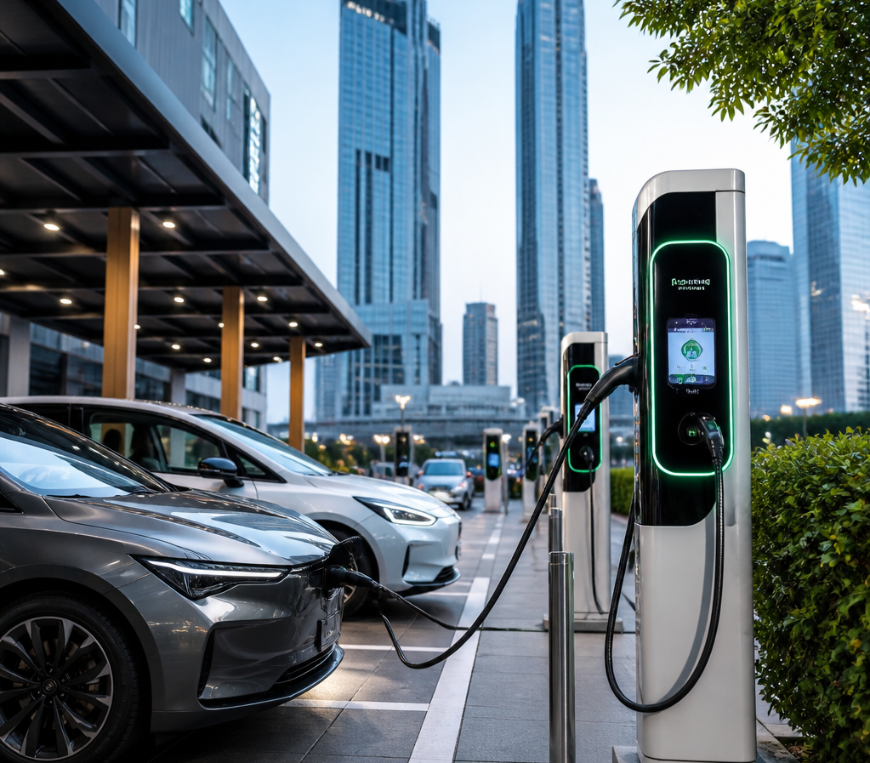
The Master Blueprint for Smart Cities
Strategic Takeaways for EV Infrastructure
Infrastructure Integration
Synchronize EV charging deployment with local grid capacity to prevent overloading.
Grid Stability
Leverage smart grid technologies to manage charging loads during peak demand hours.
Economic Feasibility
Balance infrastructure investment costs with long-term operational profitability.
EV planning must integrate grid constraints to protect infrastructure while ensuring profitability.

